Slide 1
Artificial neural networks (ANNs)

Slide 2
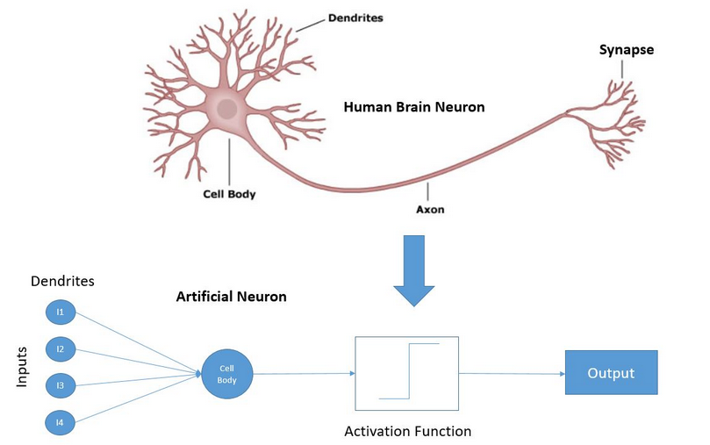
The neuron model
The most popular neuron model is the “perceptron”
Invented by Rosenblatt in 1957
He argued that the model behaves similarly to biological neurons
  Many inputs – “dendrites”
  One output – “axon”
  When the (weighted) sum
  of the stimuli reaches a
  threshold, the neuron fires,
  otherwise not – the output
  of the neuron is binary
  (in the original model),
  this is the purpose of the
  activation function

Slide 3


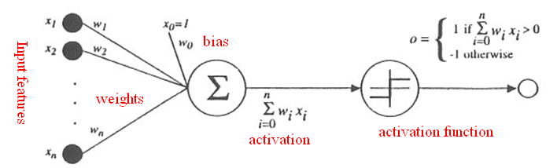
The “perceptron” neural model
The inputs correspond to the x₁…x_{n} features
The strength of the connections is modelled by the w₁,..,w_{n} weights
There is an additional w₀ “bias” parameter
The overall activation of the neuron is calculated as:
Or, using a fixed input x₀=1 :
The activation a is converted into the output o(a) by the activation function
  In the original model this performs a simple thresholding:
The parameters to be learned are the w₀,..,w_{n} weights

Slide 4
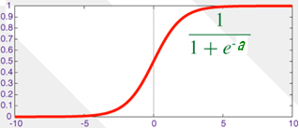

Training the neuron
The perceptron model is basically a linear classifier
We presented several solutions for their training earlier
Instead of Rosenblatt’s original percetron model (and learning rule) nowadays we prefer the version where we use the sigmoid function as the activation function
So the σ activation function and the neuron’s output is given as:
We called this the logistic regression model earlier
We also showed that it can be trained using the gradient descent algorithm
  By minimizing either the cross-entropy or the MSE error function

Slide 5
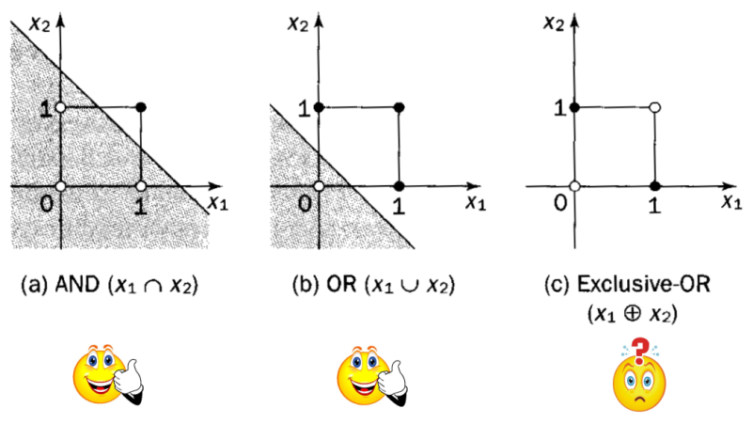
The representation power of one neuron
The perceptron model is equivalent to a linear classifier
In practice, very few tasks can be solved by a simple linear classifier…
Minsky és Papert showed in 1969 that AND, OR can be learned by one neuron, but the XOR operation cannot be represented
Research of the neural model was neglegted until the early 80`s
  This time period is known as the first “AI winter”

Slide 6
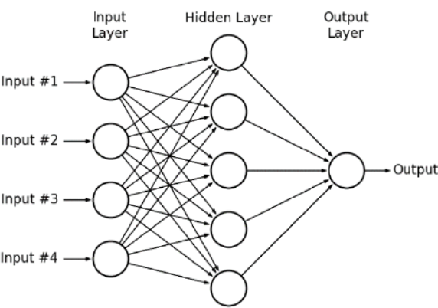
Neural networks
How can we increase the power of the model? Let’s build a network!
The outputs of one layer form the inputs of the subsequent layer
  Mathematically this corresponds to embedding functions into each other
The classic architecture is the multilayer feedforward network
  Each layer receives it’s input from the
  previous layer
  The layers are „fully connected”:
  each neuron with each neuron
  Only feedforward connections
Relatively unusual, but:
  We may construct a sparse network instead of a fully connected one
  The connections also may skip layers
A recurrent structure is also viable, but it is much more difficult to train (see recurrent neural networks)
  In practice, these are used to model time series

Slide 7
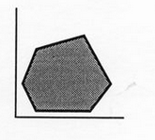
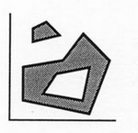
Representation power of a neural network
Separating a convex area: 1 hidden layer is enough
  Each neuron in the hidden layer corresponds to one
  boundary line
  The output neuron performs an AND operation: it fires
  where ALL the hidden neurons fire
Learning an arbitrary (non-convex, not connected) area:
2 hidden layers are enough
  Neurons in the first hidden layer correspond to lines
  Neurons in the second hidden layer perform AND
  operations to cover convex areas
  The output neuron connects these areas by an OR operation into non-convex, non-continuous regions
Theoretically any practical learning task can be solved by using a neural network with 2 hidden layers
  But arbitrary precision would require an infinite amount of training data, infinite number of neurons and a training algorithm which guarantees global optimum…

Slide 8
Connection with statistical pattern recognition
The previous slide showed how can a network separate the classes (geometrical view)
But it can also be showed that the operation of the network also can be interpreted by the decision theoretic view under certain conditions
  We assign an output neuron to each c_{i} class
    We expect these to approximate P(c_{i}|x) of the given class
  Using the outputs, we classify a given input using Bayes’ decision rule
    We select class c_{i} with the largest P(c_{i}|x) output value
  The proof that ANNs can approximate the P(c_{i}|x) values required by Bayes’ decision theory increased their popularity in certain areas
  Knowing the P(c_{i}|x) probabilities can be used not only for classification (by selecting the most probable class), but also for several other purposes
    Eg. as a confidence measue of how much the given output is reliable

Slide 9

The network output as a probability distribution
What are the requirements for the network outputs to approximate the P(c_{i}|x) posterior probabilities?
  There should be an output neuron assigned to each c_{i} class
    We expect these to approximate P(c_{i}|x)
  We apply the softmax activation function for the output neurons
    All outputs fall in the [0,1] range, with their sum being 1 (see linear machine!)
  The training labels should form an 1-of-M coded vector
    It is an M-sized vector (M is the number of classes), which contains only one 1:
  As the error function use either the MSE or the cross-entropy error
And don’t forget that in practice you will get only an estimate of the P(c_{i}|x) distribution!
  You would need infinitely many neurons, infinitely many training samples, and a perfect training algorithm…

Slide 10



Network output as a probability distribution
Theorem: The outputs of the network constructed and trained according to the previous conditions the will approximate P(c_{i}|x)
The outline of the proof:
  Let’s suppose that the networks receives the same x input a lot of times but with different c target values
  But the network can return only one o output for a given x
  Let occ(c) denote the number of occurences of each c value. Then we can write the mean square error as:
  If the examples faithfully represent the P(C) distribution then, according to the law of large numbers,
  So

Slide 11

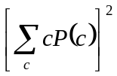
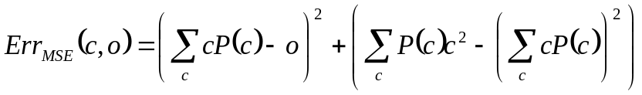

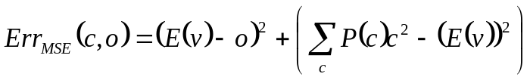
Network output as a probability distribution
Which value of o will minimize ?
Decomposing the parenthesis gives:
Making use of , and also adding and substracting , we can write
Let’s interpret the different values of c as the values of a stochastic variable v. Then the expectation is , so
As the second term is constant, we can minimize the error by minimizing the first term, and it takes its minimum when o equals the expectation of v

Slide 12
Network output as a probability distribution
We said that the training labels will be presented to the net as
1-of-M coded vectors
  So each label can take only the values of 1 or 0, and it takes 1 exactly when the given samples belongs to class c; let’s denote this even as c
In this special case, the expectation of v is:
So, by minimizing the MSE error, the network output will approximate P(c|x) in each x point
  But don’t forget that we need a lot of examples so that the ratio of the samples that belong to class c should approximate P(c|x)
  In real-life situations we always get only an approximation
A similar proof exists for the cross-entropy error function as well

Slide 13
Training the neural network
A ”network” consisting of just one neuron is equivalent with the logistic regression model presented earlier
We also saw that we can train this model using the gradient descent algorithm, using either the MSE or CE error function
In the multi-class case we put one neuron for each class in the output layer, and in this case we can apply multi-class logistic regression (also presented earlier)
The real novelty here is when we build a multi-layer network. In this case the output of the lower layers form the input of the upper layers, which mathematically corresponds to a function embedding
The gradient descent algorithm is still applicable, but the error must be propagated back from the upper layers to the lower layers
  This is the so-called backpropagation algorithm

Slide 14
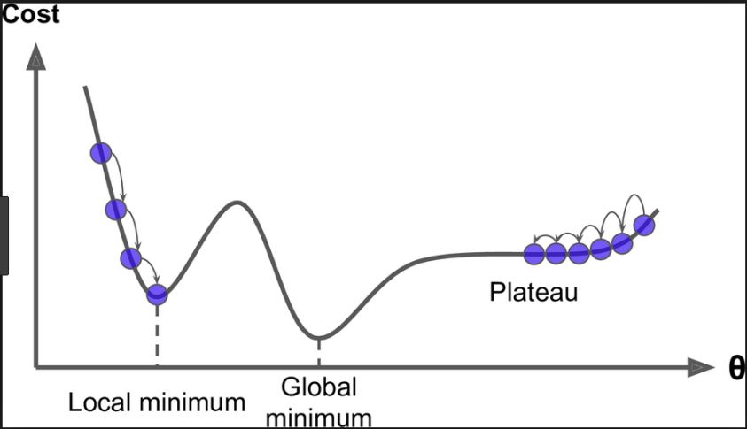
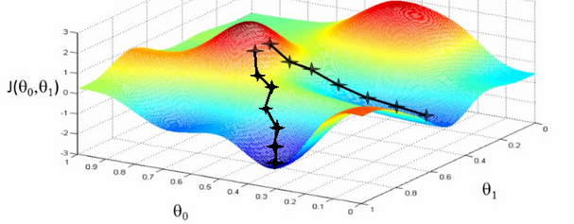
Gradient descent - reminder
A variant of the „hill climbing” algorithm for continuous functions
  The gradient helps us find the direction of where to move on -
  the steepest descent principle tells us to move in an opposite direction with the gradient
  Ww start from a random initial point
  The step size („learning rate”) is chosen heuristically
  The method is iterative (we go on until we get stuck)
  Generally only a local optimum is guaranteed to be found

Slide 15
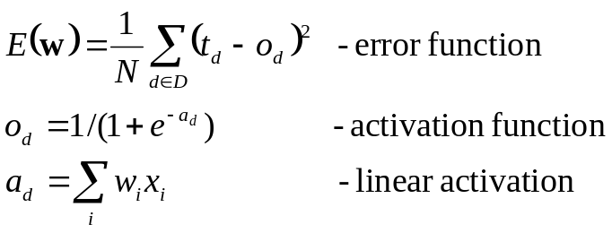
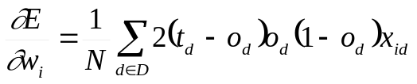
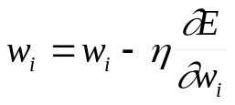
The backpropagation algorithm
Illustration for just one neuron, using the MSE cost function:
The dependency of E(w) from w_{i} is given by embedding these functions into each other
To calculate the derivative of these functions we use the chain rule
And the weight update rule of gradient descent is:
  Where η is a small positive constant („learning rate”)

Slide 16

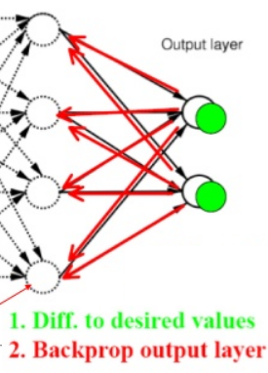
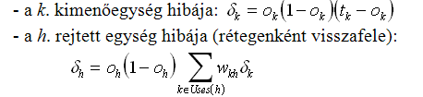
The backpropagation algorithm 2
General case: many output neurons, multi-layer network
  We have to apply the chain rule as before, but for more steps
  (the input of the output neurons is not x, but the layer underneath)
    (in the derivation below the sum over D is omitted for simplicity)
    The derivative (or shortly : „the error”) is first calculated for the output layer
    And then it is propagated back layer-by-layer to the lower layers
    Interpretation: the error of a hidden neuron is proportional to
    the weighted sum of the errors of those neuron that use its
    ouput
        Where the weights are the weights of the given connection
The error of the kth output unit:
The error of hidden unit h:

Slide 17
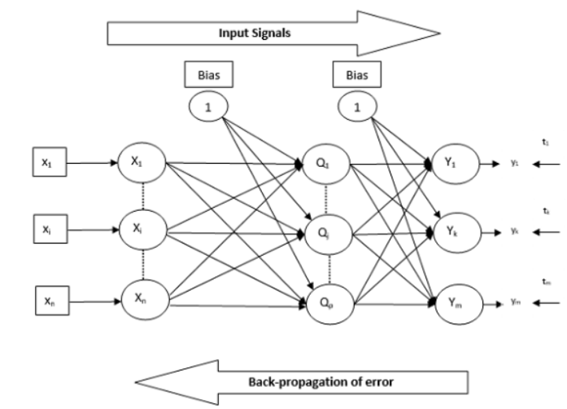
The backpropagation algorithm 3
In summary, the main steps of backpropagation training:
  From the input to the output, we calculate the
  output of each neuron on the samples set D
    To calculate the error we first need the outputs!
  From the input to the output, we calculate the
  error of each neuron
  We update the weights:
Remark: The backpropagation algorithm also allows sparse structures, or the skipping of layers. The only requirement regarding the architecture is that is should not contain circles
  No circles → we can calculate the output and the error following a topological ordering
  In the case of circles in the graph we obtain a recurrent network – training these is much more complicated

Slide 18
Stochastic backpropagation
The cost functions are defined as the average error over all samples:
  To evalute this we have to process all the data. This prohibits online training
On-line backpropagation is when we omit the summation over D. Instead of this, we perform the evaluation, backpropagation and weight update steps after receiving each sample
Batch backpropagation is when we update the weights after receiving a block or „batch” of data
  In this case we optimize a different version of the cost function in each step! (ie. the error calculated over the given batch)
  Surprisingly, this is not harmful but beneficial: it introduces a small randomness in the system which helps avoid local optima
    This is why it is called stochastic gradient descent (SGD)

Slide 19
Batch backpropagation
The advantages of training in batches:
  Lower risk of getting stuck in local maxima
  Faster convergency of training
  On iteration is faster (no need to process all the data in each step)
  Implementation is easier (one batch of data fits in the memory)
  It allows for online or semi-online training
This is the most popular training scheme
The typical batch size is 10-100-1000 examples
As in the case of training on all the data, we usually go more rounds over the full data set
  One „round” on all the training data is known as a “training epoch”

Slide 20
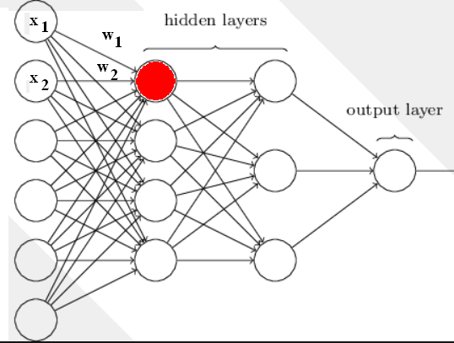
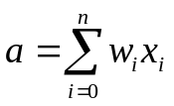
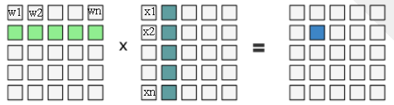
Batch backpropagation for GPUs
Why is it more efficient to train neural networks on GPUs?
  Calculating the activation of
  one neuron:
  =vector-vector multiplication
  But the activations of the neurons
  of a given layer can be calculated
  in a parallel manner!
  =matrix-vector multiplication
  And the above can be done
  in parallel for a batch of
  input vectors!
  =matrix-matrix multiplication
  GPUs can calculate the components of a product matrix in a parallel manner – this is 30-40 times faster than using just one CPU

Slide 21
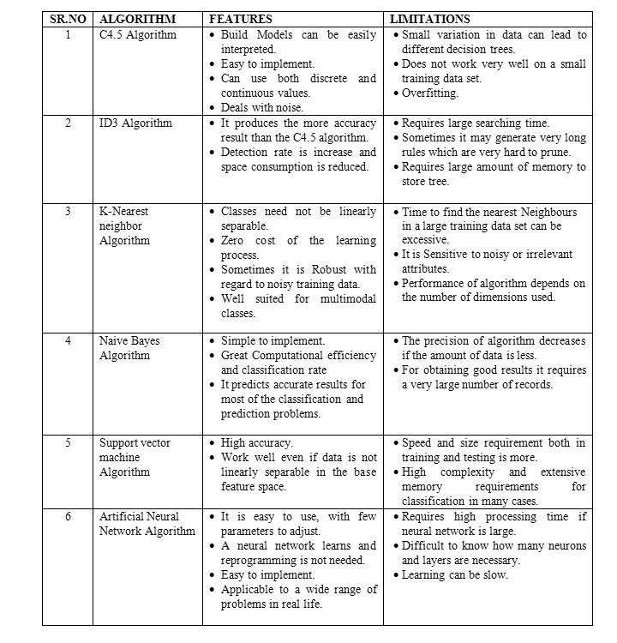
Algorithm

